Slide 1


HRMS Training
4. Recruitment HRM

Slide 2
PROCESS FLOWCHART – RECRUITMENT
New Requirement
Approved by GM HR & Admin
Not Approved
Develop Job ad & Post on (LinkedIn-Indeed- WhatsApp
(Kamran)
Manpower Requisition by Department HOD
Qualification, Expertise, Skills
JD Finalization
Saleha & Kamran
Replacement
Approved
Final Interview (GM-HR & Admin / HOD / CEO)
Executive & above
Resume Sourcing (Internal & External)
Initial Resume Screening
(Kamran)
Shared resumes with HOD to review and share Date & Time
Telephonic Interview to align Interviews
Interview with Domain Management
Officer / Trainee
Prerequisite Documentation
Intimation to concerned Department
Yes
Offer Accepted
Candidate Finalization
Internal Equity Analysis & Salary Package Finalization
Reference Check
Offer to Candidate
No
Employee Joining

Slide 3
MANPOWER MODULES
1
2
3
HODs Module
HR Module
Candidate
Module
Manpower Requisition
New
Replacement
Requisition
Posting Jobs
Resumes Bank
Profile Account

Slide 4

MANPOWER HODs MODULE (Resource Requisition)

Slide 5
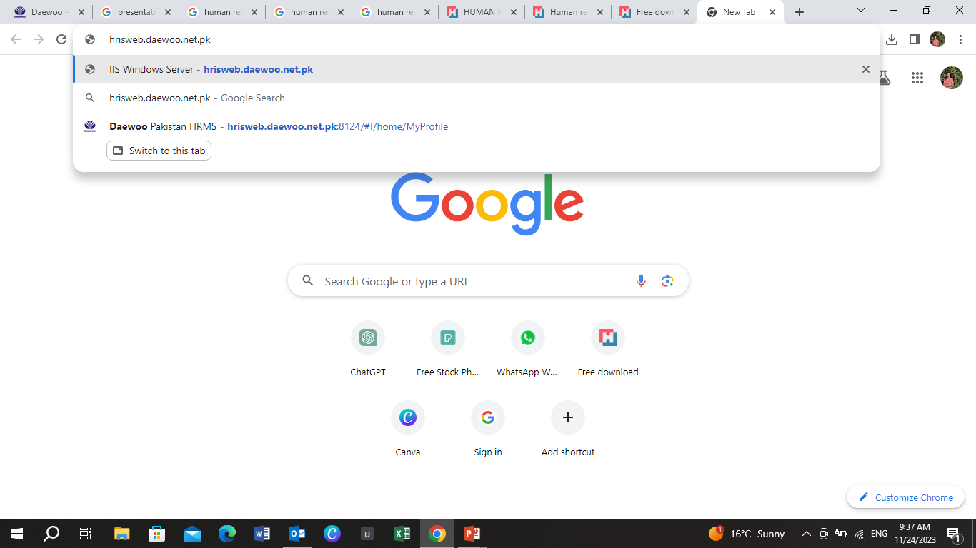
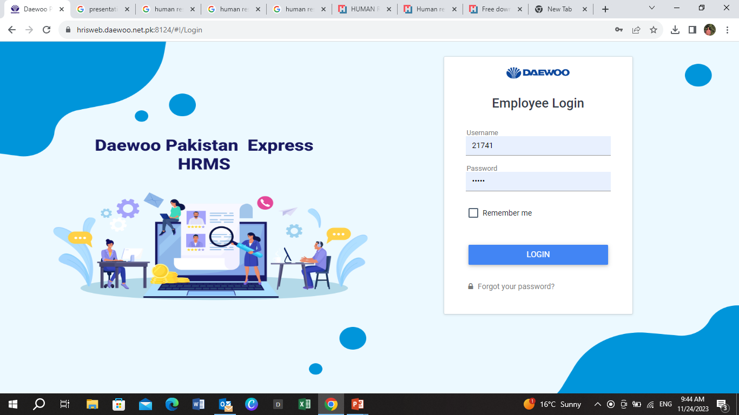
STEP 1
Open Google Chrome. Enter the URL
hris.web.daewoo.net.pk
STEP 2
Enter your Login Details
(Employee username &Password) to login to your profile

Slide 6
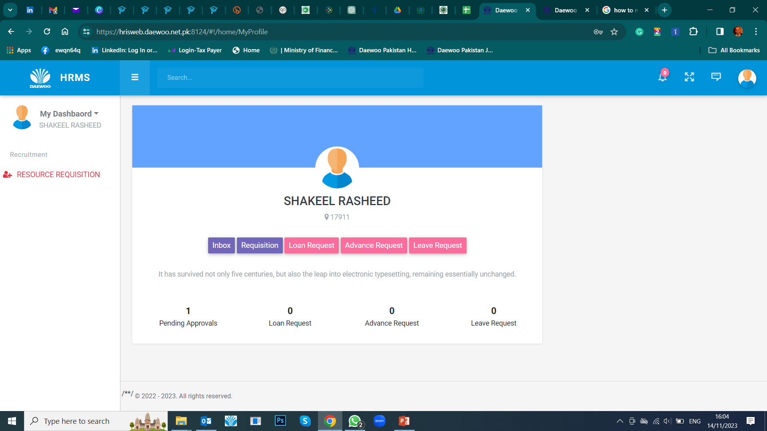
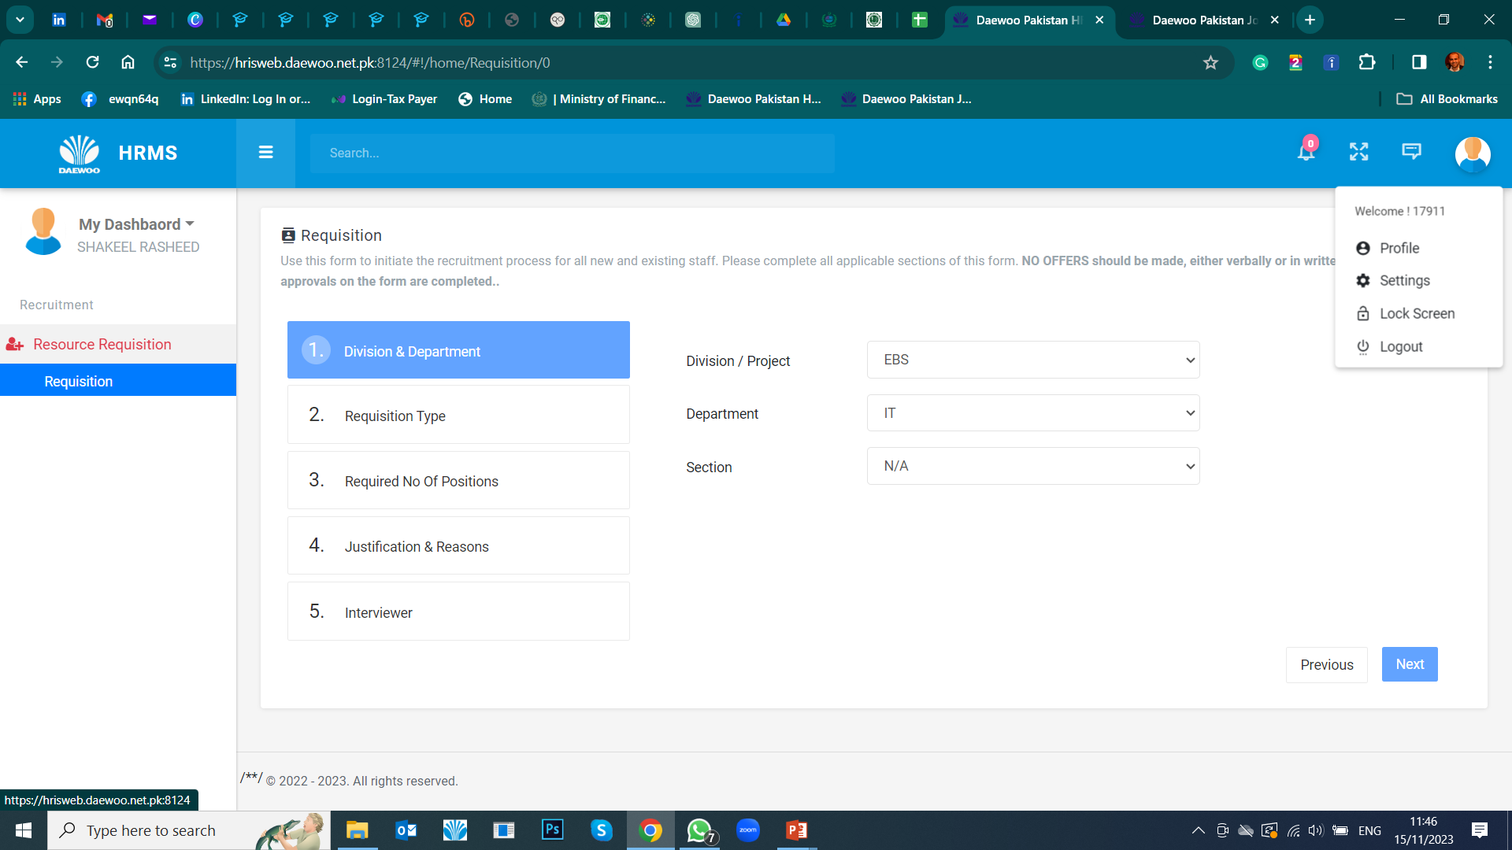
HOD’s/Managers Logins
Employee Profile
Manpower Requisition Tab
Inbox: Requested requisition Record
Requisition: Search record
THESE TABS ARE NOT OPERATIONAL YET.

Slide 7
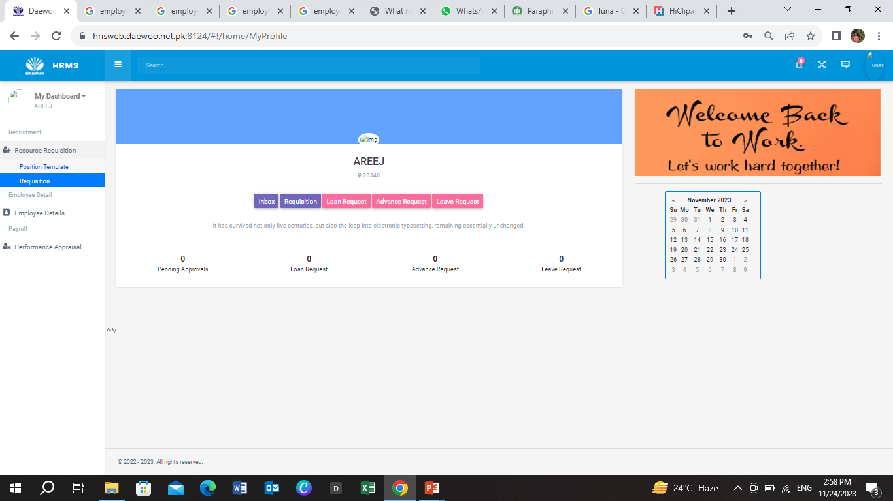
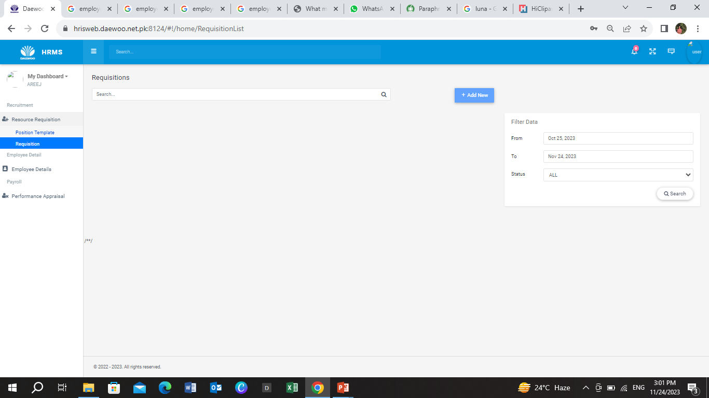
Homepage will appear
STEP 3
On Left side of homepage, click Resource Requisition
STEP 4
Enter Valid date & status
STEP 5
Click ADD NEW

Slide 8
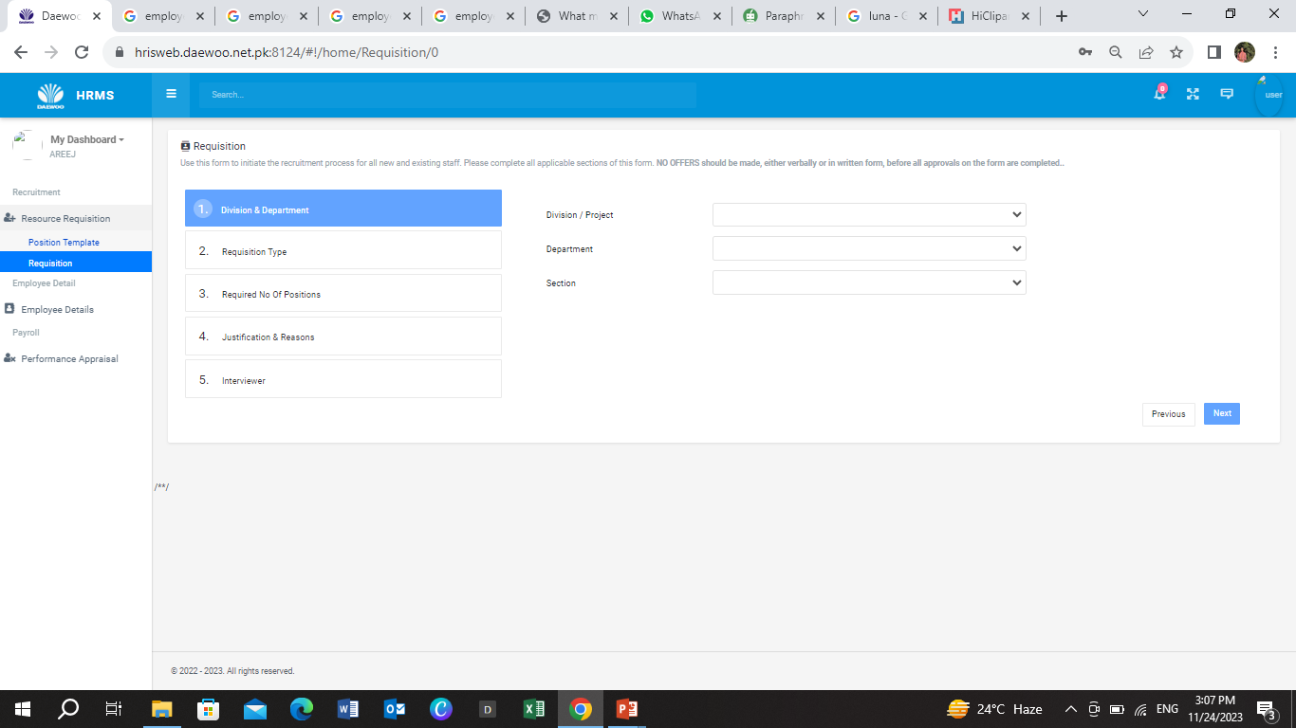
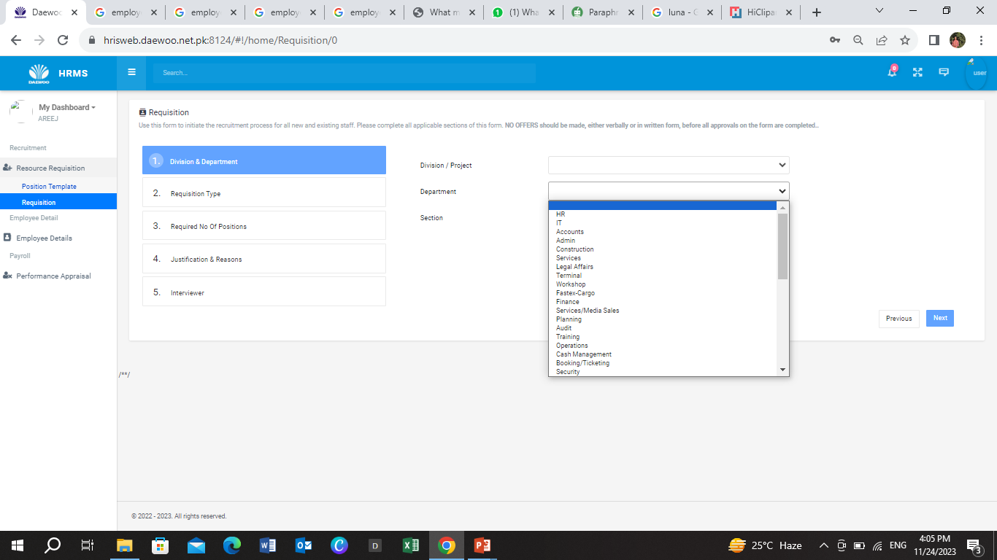
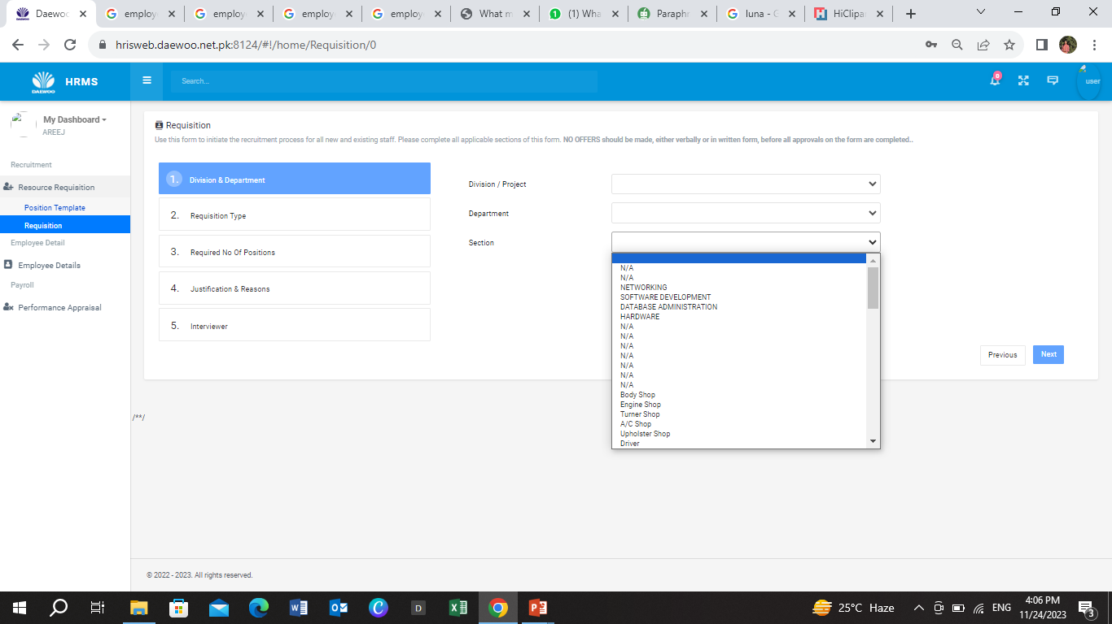
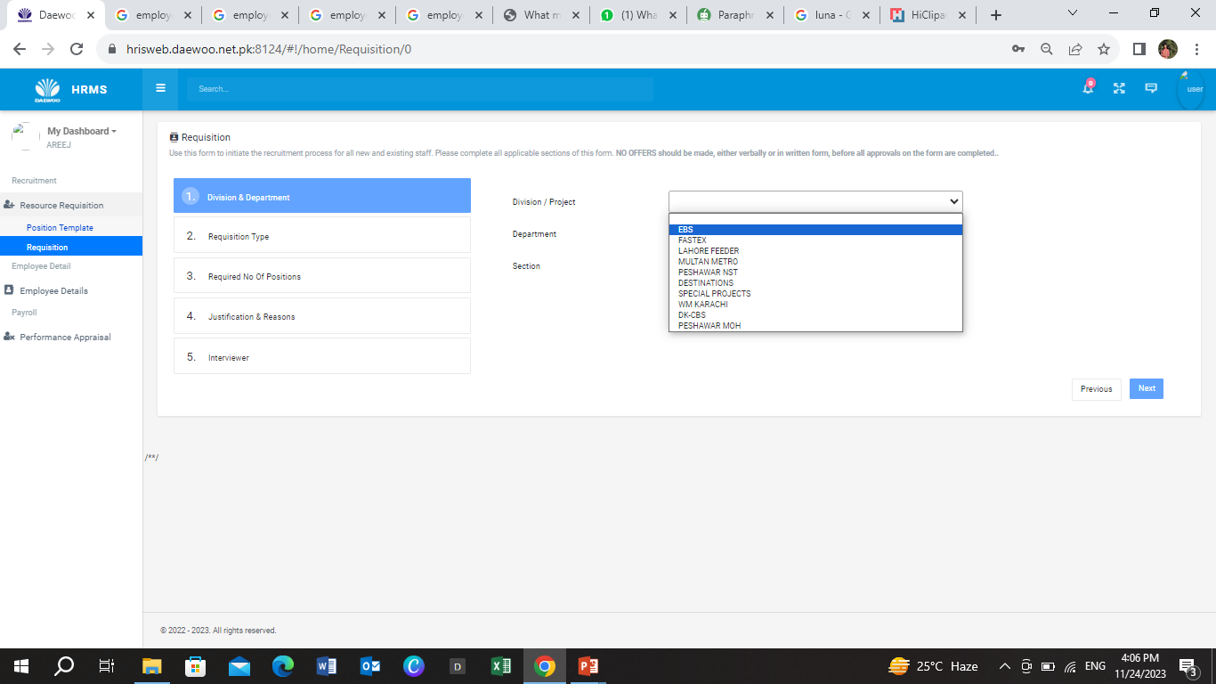
On this Page you’ll see 5 stages. Each step require various sections to fulfil before proceeding. Make sure to enter all relevant & required information
STEP 8
From Department, select the relevant one.
Stage 1
STEP 9
After entering all, click NEXT to proceed
STEP 7
From Section, select relevant one.
STEP 6
From Division, select the relevant option from given

Slide 9
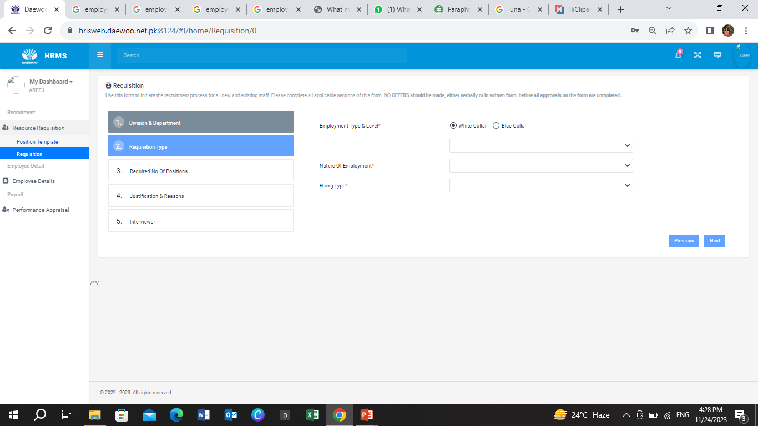
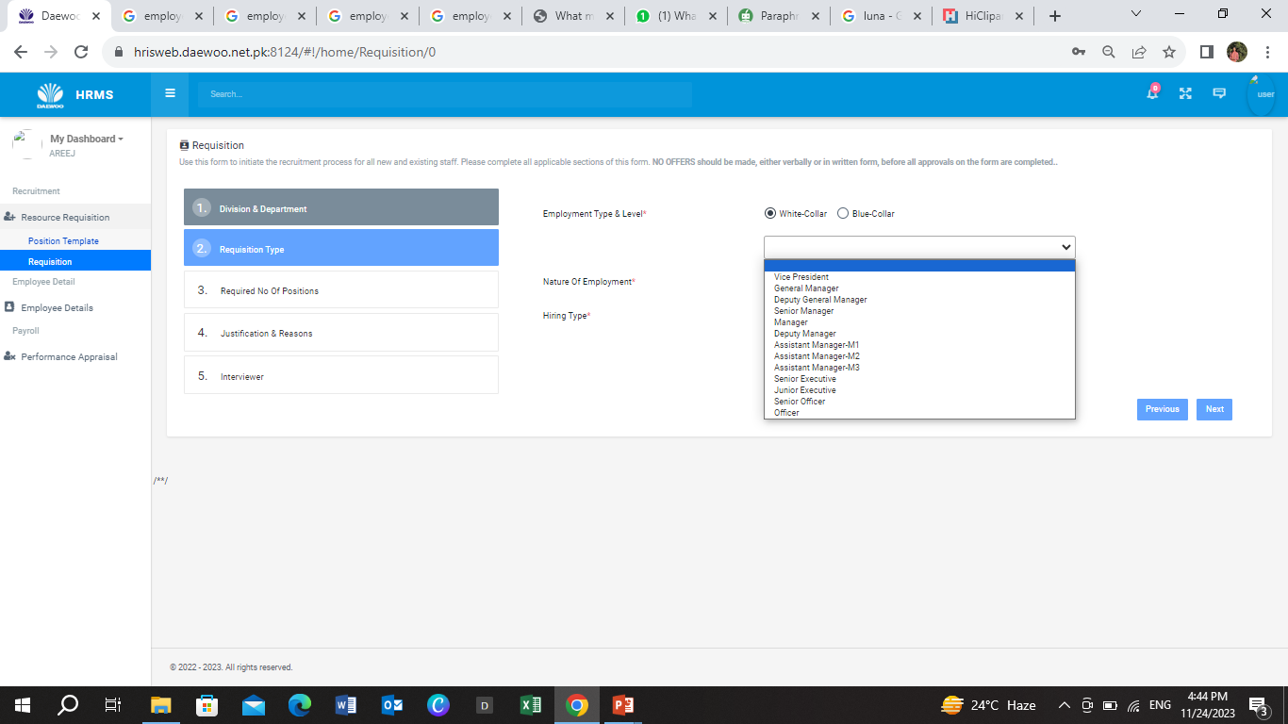
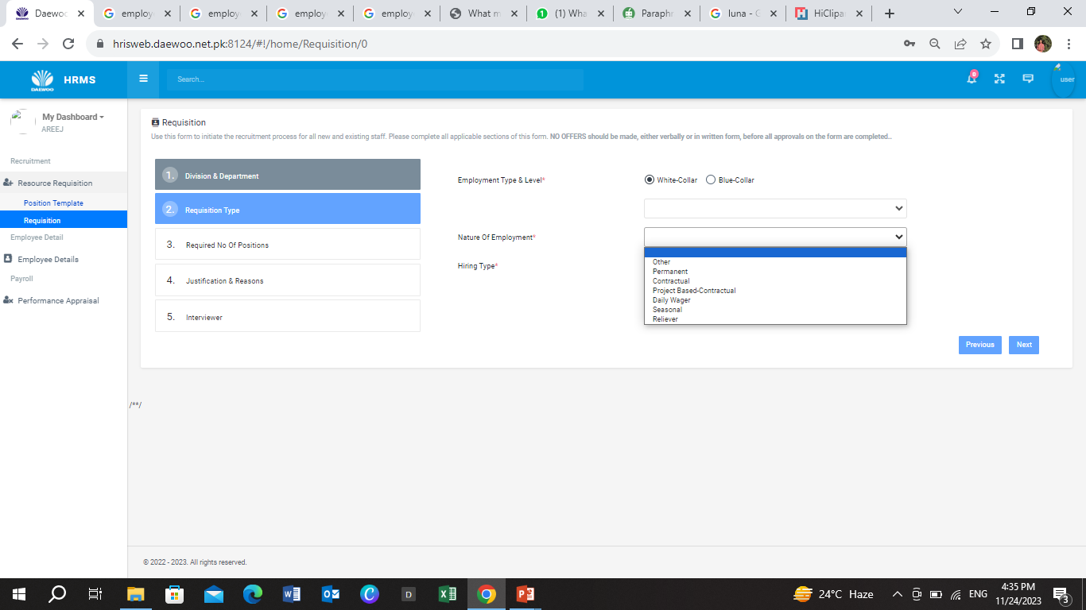
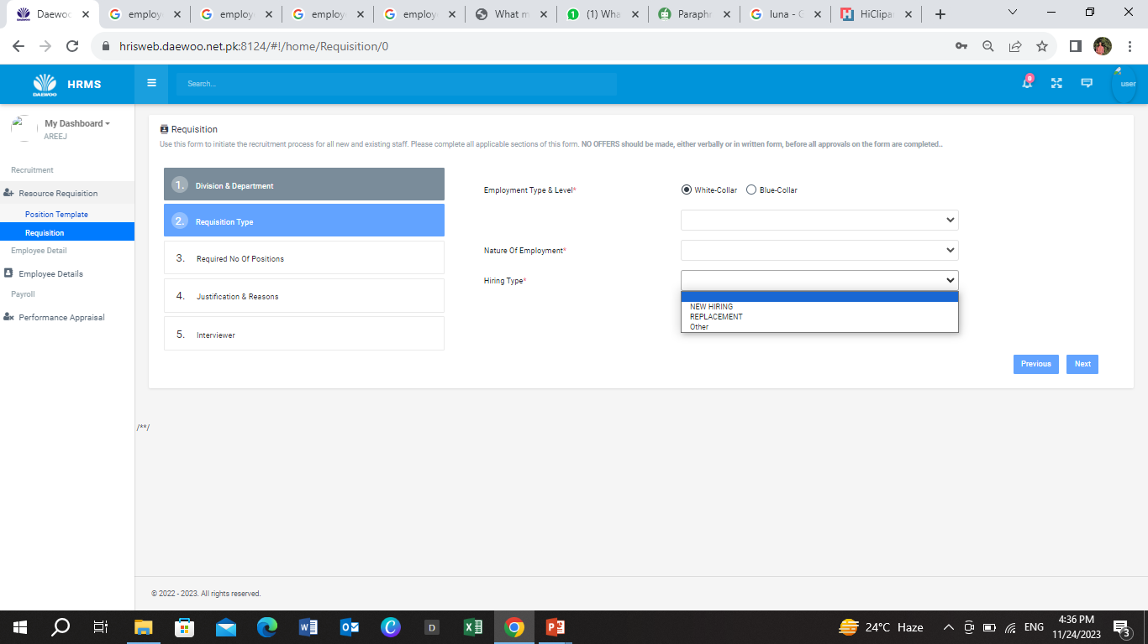
The * symbol means you must complete that item.
STEP 10
Stage 2
Select one relevant option
STEP 12
From given options, select the relevant one.
STEP 11
From given options in hiring type, select the relevant one.

Slide 10
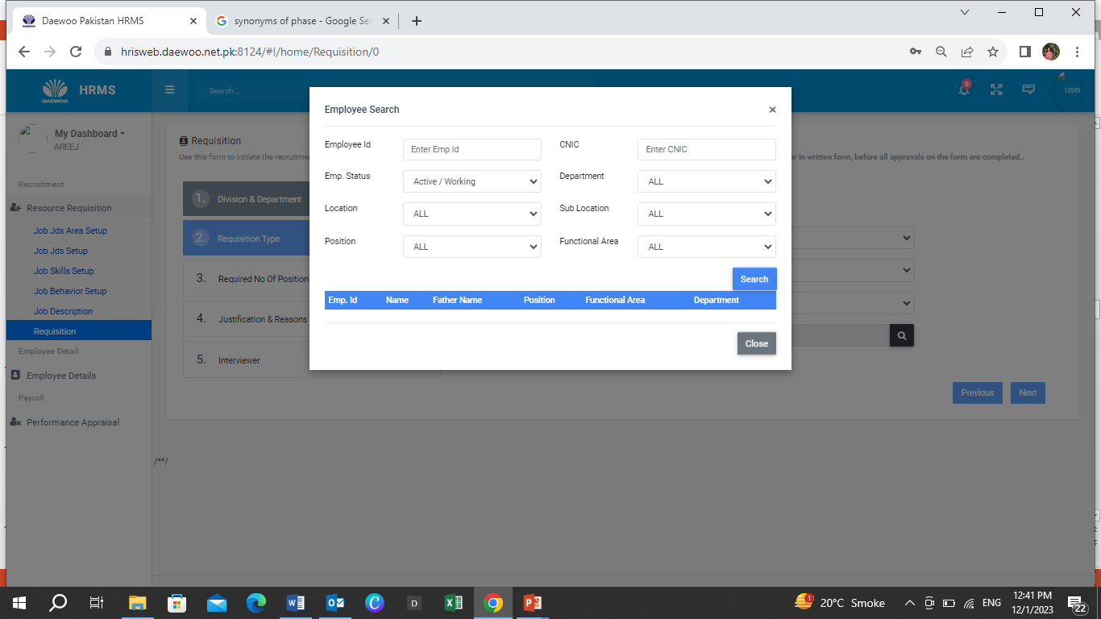
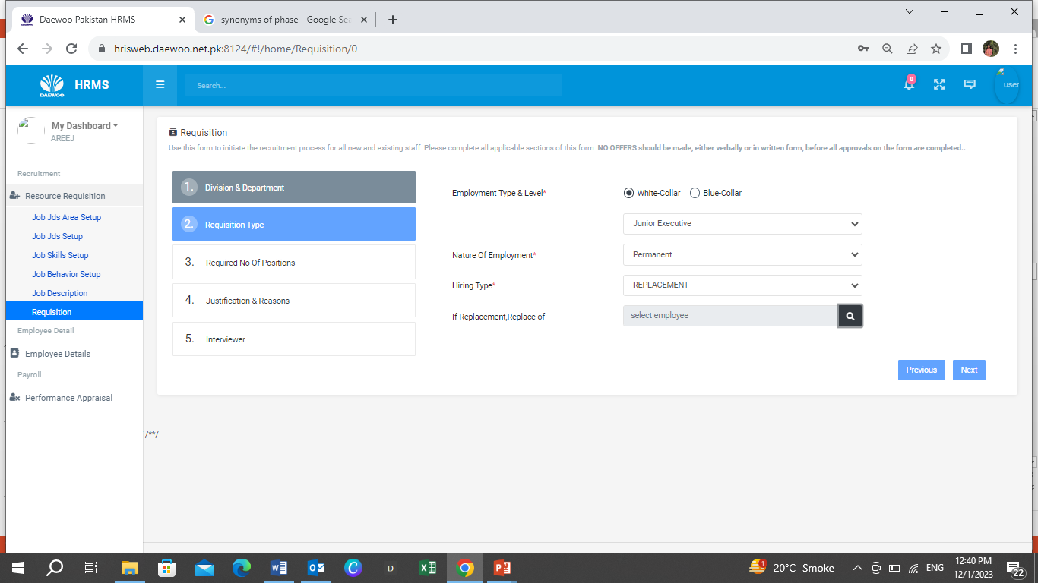
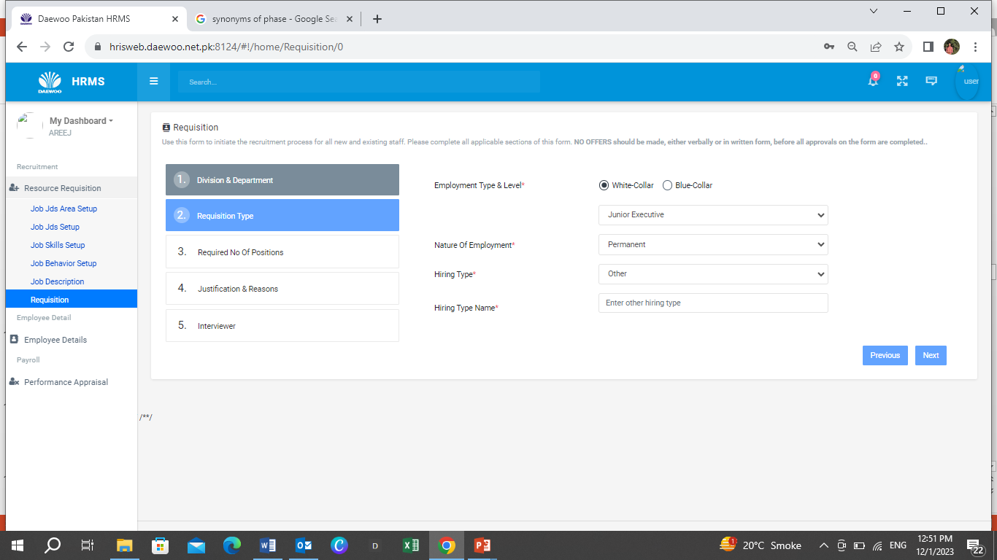
The * symbol means you must complete that item.
STEP 14 (a)
In case of Replacement, mention Employee details who’s being replaced
STEP 14 (b)
In case of Others, mention hiring type properly.
STEP 15
After entering all information click NEXT to proceed

Slide 11
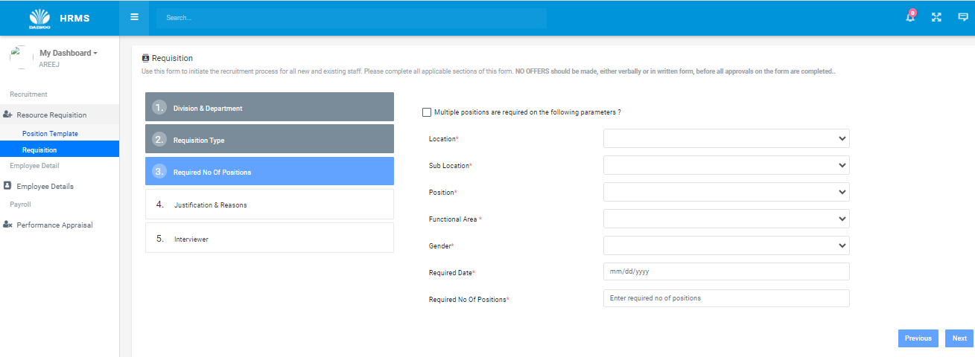
STEP 16
Check this, if need different level positions at same time.
Stage 3
STEP 17
Each section contains options, Select the most appropriate and relevant as per your requirement.
All are mandatory to fill.
STEP 18
After entering all information click NEXT to proceed

Slide 12
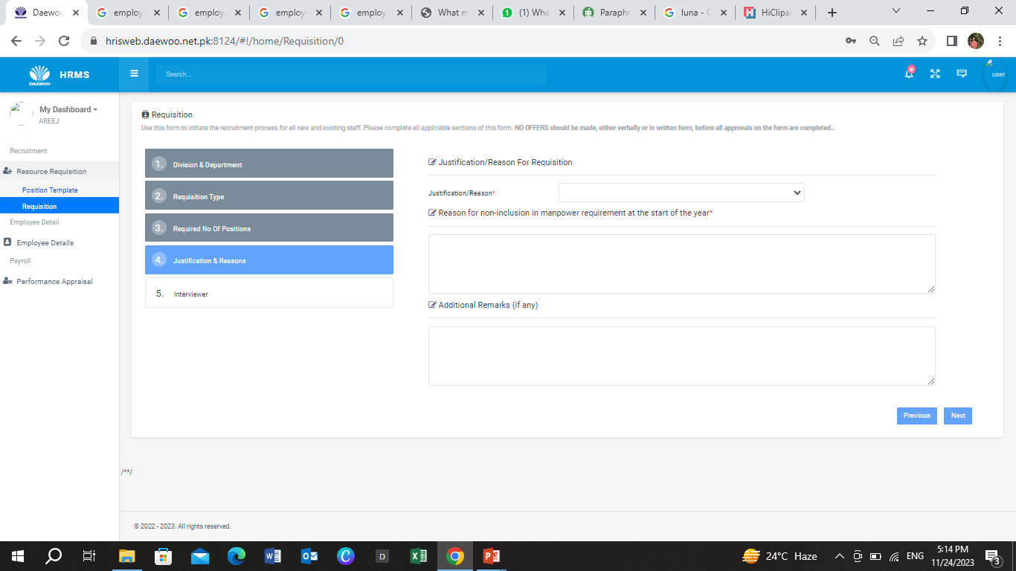
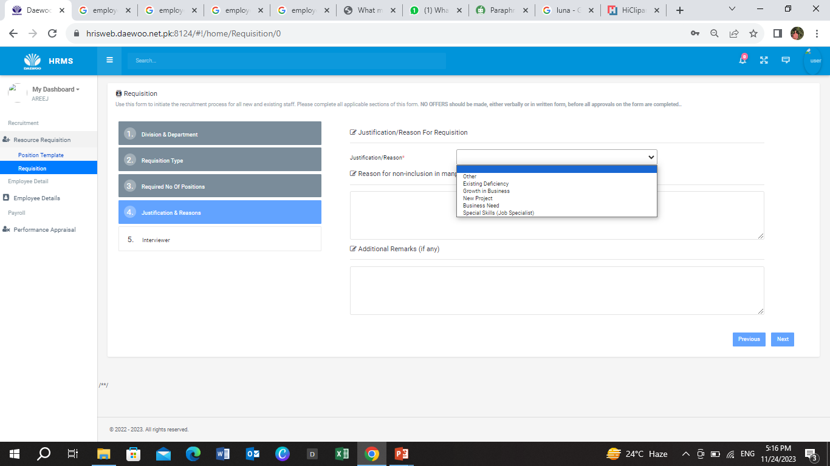
STEP 19
Select the appropriate reason amongst given .
Stage 4
STEP 23
STEP 20
After entering all information click NEXT to proceed
Give the appropriate reason of not including this position requirement at start of year.
STEP 21
Share additional remarks/ comments

Slide 13
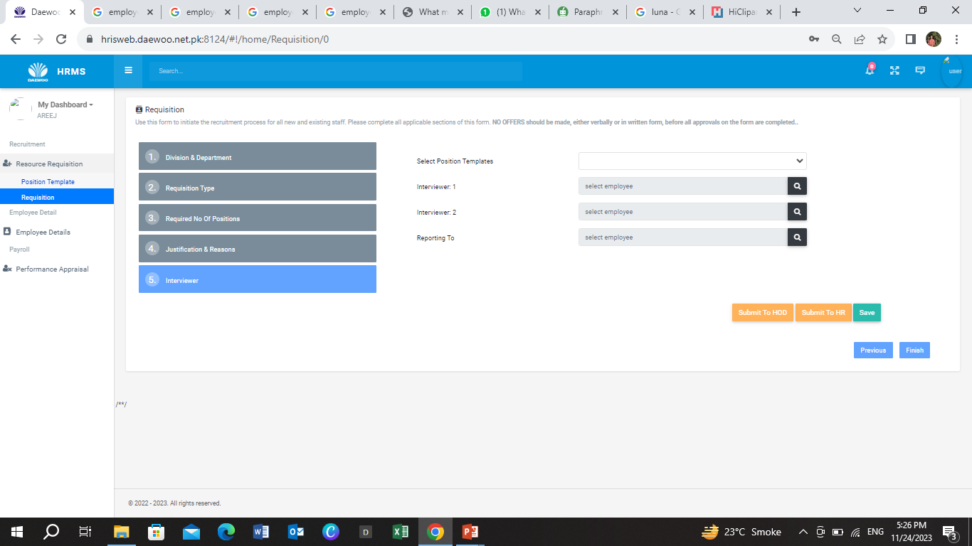
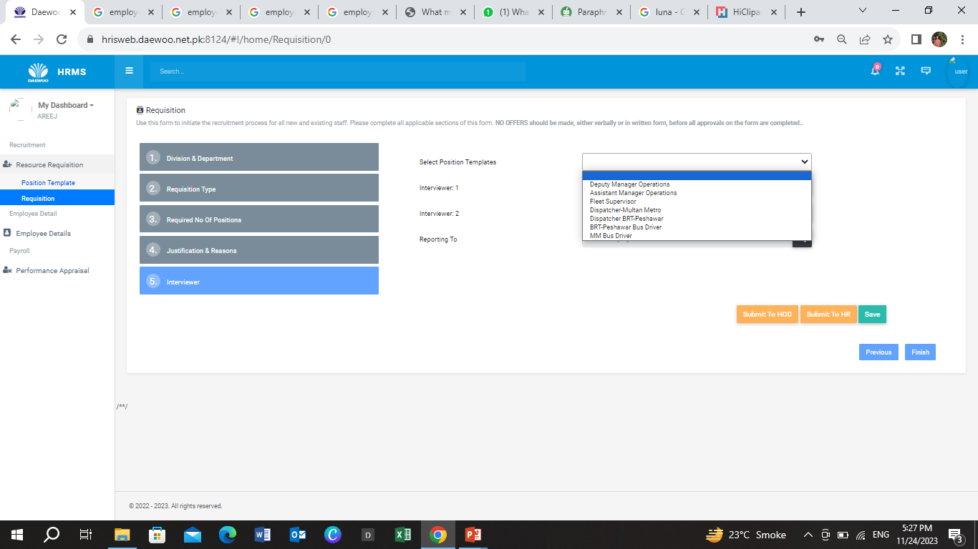

STEP 24
From Position Template, select the required one
STEP 25
Department HOD will authorize subordinate to conduct interviews in case of busy schedule.
Choose the person to whom the candidate will report.
Stage 5
STEP 26
Complete the form carefully and after completion click Submit to HOD, SUBMIT TO HR.
At the end click Finish

Slide 14

HUMAN RESOURCE MODULE

Slide 15
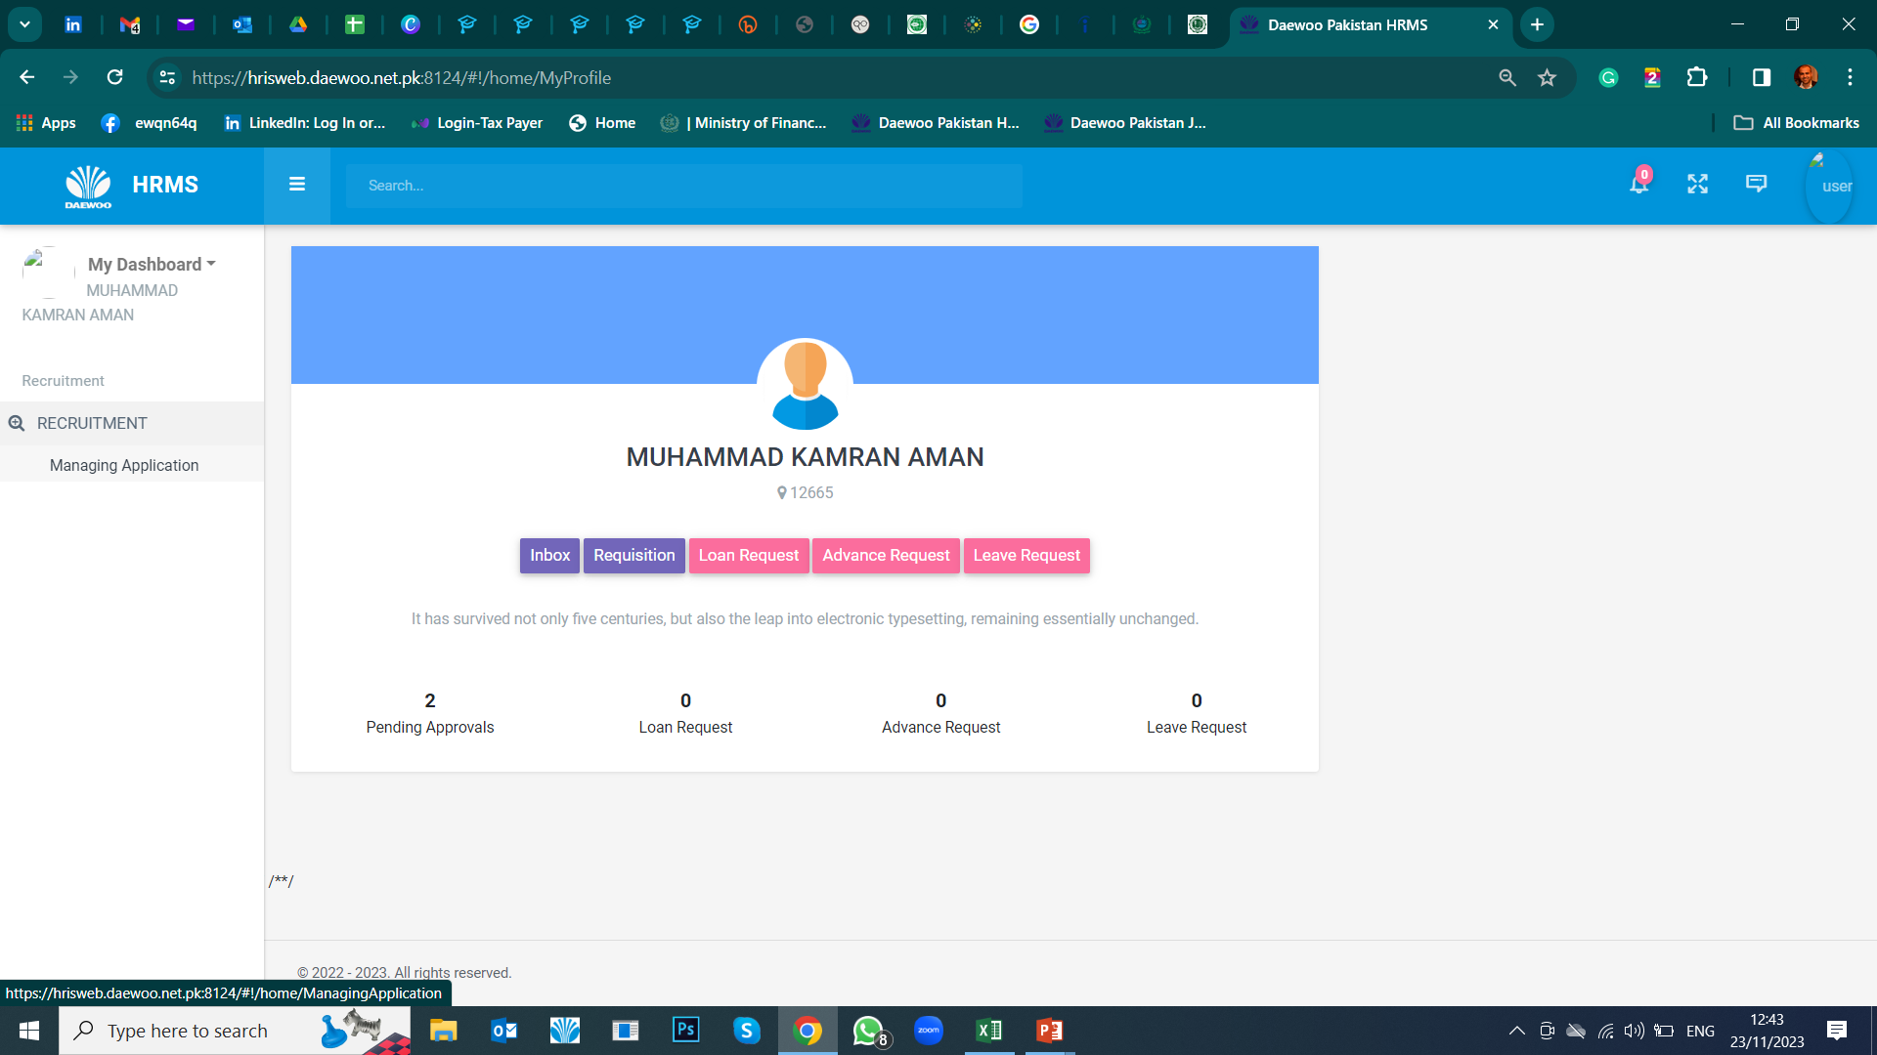
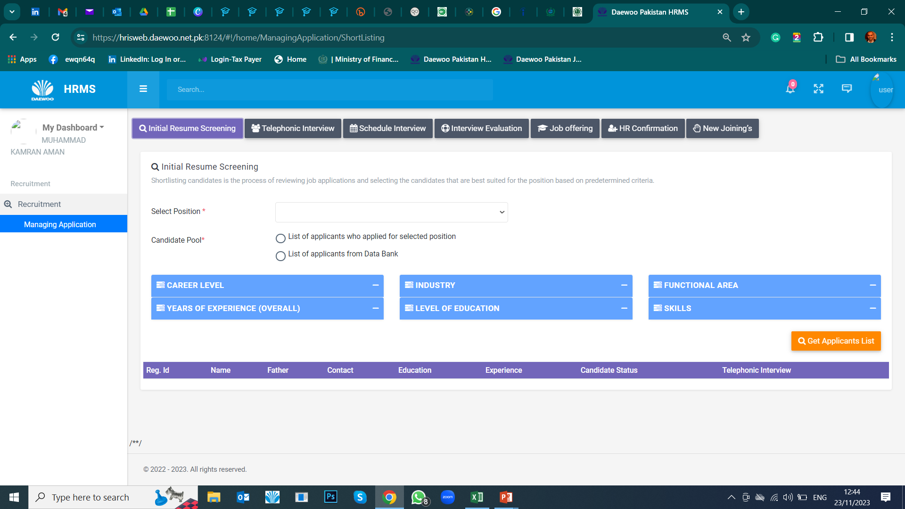
For HR use only!

Slide 16

APPLICANT MODULE

Slide 17
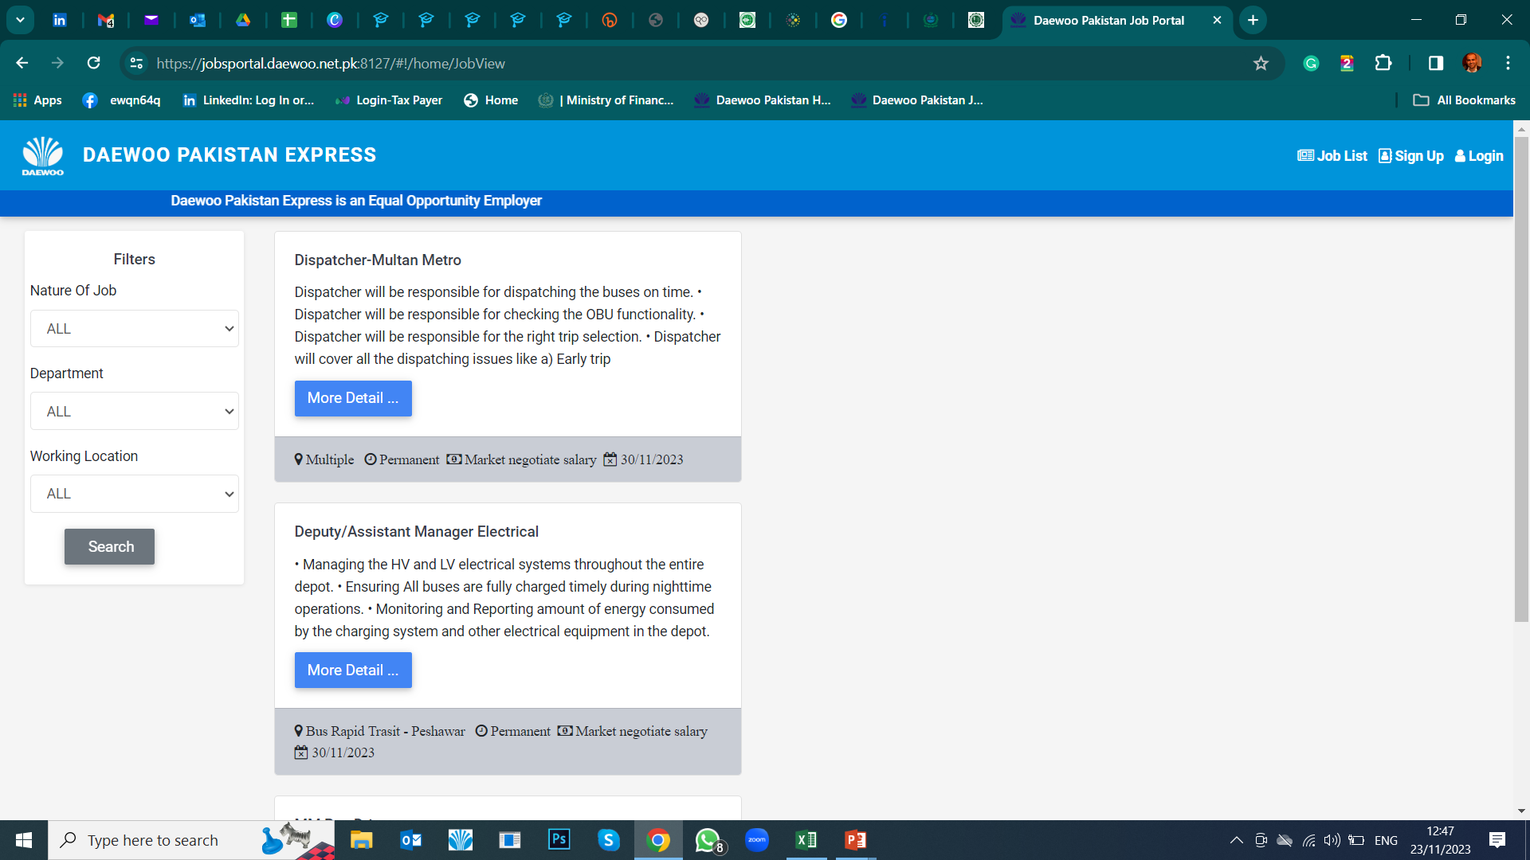
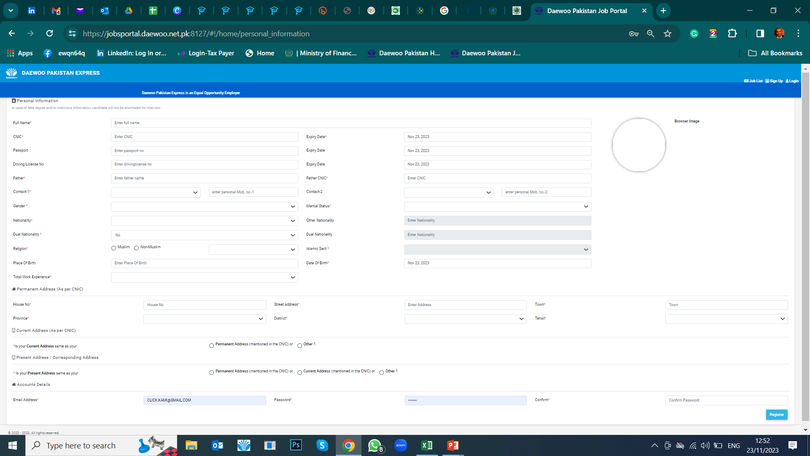
JOB PORTAL
Sign up details of Applicant
For HR use only!

Slide 19
Once Again….
Together we can achieve more
All for one and one for all!
“Coming together is a beginning.
Keeping together is progress.
Working together is success”
"No one can whistle a symphony. It takes a whole orchestra to play it.“
“Teamwork makes the dream work”
Believe in yourself. You are braver than you think, more talented than you know, and capable of more than you imagine.

